Slide 1
Employee Data Analysis using Excel
STUDENT NAME:RAHUL RITHIK.M
REGISTER NO:122200920,41807DA678DEF17A6DC439C2B5F5C0BD
DEPARTMENT:BACHELOR OF COMMERCE (CORPORATE SECRETARYSHIP)
COLLEGE:K.C.S.KASI NADAR COLLEGE OF ARTS AND SCIENCE

Slide 2
PROJECT TITLE
SATISFACTION LEVEL BASED ON DEPARTMENT

Slide 3


AGENDA
Problem Statement
Project Overview
End Users
Our Solution and Proposition
Dataset Description
Modelling Approach
Results and Discussion
Conclusion
3/21/2024 Annual Review

Slide 4

PROBLEM STATEMENT
The problem statement could be framed as: "analyse the employee satisfaction levels across different departments in the organization to identify areas that may require attention to improve overall job satisfaction. "This could involve investigating why certain departments, such as IT or Technical (which seem to have lower satisfaction levels based on the pie chart’s size distribution), have differing levels of satisfaction compared to others.

Slide 5

PROJECT OVERVIEW
This is a pie chart visualizing the distribution of expenses across different categories in a project. The largest slice, representing 47%, indicates that nearly half of the project’s budget is allocated to a single category. The remaining slices range from 3% to 14%, illustrating the allocation of the rest of the budget across various smaller categories.

Slide 6

WHO ARE THE END USERS?
It looks like the end-users in this pie chart are the employees from different departments within a company. The departments listed are: Accounting, HR, IT, Management, Marketing, Product Management, Sales, Support, and Technical. It looks like the end-users in this pie chart are the employees from different departments within a company.
The departments listed are:
Accounting, HR, IT, Management, Marketing, Product Management, Sales, Support, and Technical.

Slide 7

OUR SOLUTION AND ITS VALUE PROPOSITION
ALIGNMENT: To enhance the visual presentation of data.
FILTERING: Select any cell within the range.
REMOVE DUPLICATES: Permanently deleting duplicate values Double tap to add title
CONDITIONAL FORMATTING: Makes it easy to highlight certain values.
BOLD TEXT: This will turn all the text in all selected cells bold
GRAPH: Represent data in a worksheet
PIVOT TABLE: To summarize, analyse, explore and present summary data.
Software filters used along with excel tables or pivot tables over a large amount of data

Slide 8
Dataset Description
AVERAGE_MONTLY_HOURS: This column seems to contain the average number of hours worked per month by an employee. TIME_SPEND_COMPANY: This column likely represents the number of years the employee has worked at the company. WORK_ACCIDENT: This column is likely a binary indicator (0 or 1) of whether the employee has had a work accident. LEFT: This column is probably another binary indicator (0 or 1) showing whether the employee has left the company.PROMOTION_LAST_5YEARS: This column indicates whether the employee has received a promotion in the last five years. POSITION: This column shows the job title of the employee. SALARY: This column shows the salary level of the employee (low, medium, or high).

Slide 9
MODELLING
Data set was downloaded from Kaggle website
Extract it from zip format.
Data Cleaning: Data cleaning is a process required to remove incomplete records, and modifying data to rectify inaccurate records.
Remove Duplicates: It removes the combination of values across all selected range to determine duplicates.
Filter: It take my dataset and show only the data that meet my criteria specify.
Conditional Formatting: It is used to specify important values stand out in employee performance score in a data set.
Slicer: I used slicer to filter my data.
Pivot Table: I used "pivot table to summarize my huge data.
Pivot Chart: I used using area graph. "pivot chart" to visually summarizes my data.
9

Slide 10
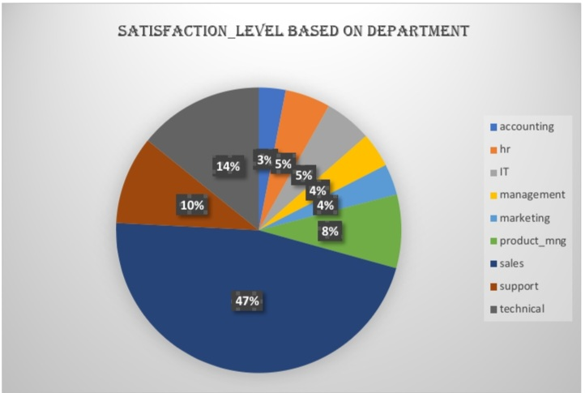
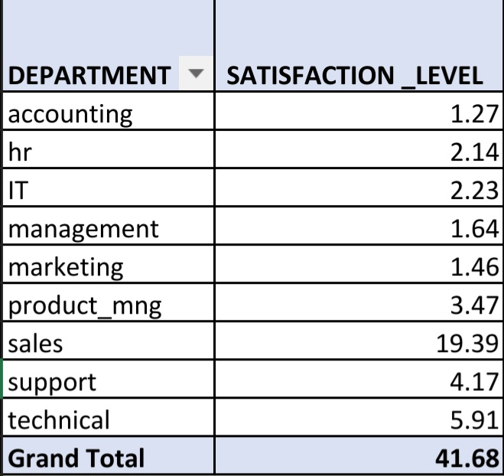
RESULTS
10

Slide 11
conclusion
This pie chart showcases a distribution across multiple categories. The dominant category holds a significant 47% share, followed by a 14% portion. Several smaller categories, each contributing between 3% and 8%, comprise the remaining data. In conclusion, the chart highlights a clear dominance of the largest category, while the remaining data is spread across several smaller categories with relatively even distribution.

